Slide 1
UI Health – Digital Transformation during COVID-19
Skandan Ganesh
Meghashree MADDIHALLY NAGOJI
Raina Miriam Jose
Sai Hruthik Reddy VARAKANTHAM

Slide 2
Table of contents
Introduction
Aim
Project Approach
UI Health Timeline
EMR Migration Plan (2018-2020)
Post COVID-19 (March 2020) : Organizational Changes
Post COVID-19 (April 2020 – August 2020) : IT Changes
Post COVID-19 (September 2020) : IT Changes
Post COVID-19 (October 2020 – April 2021) : IT Changes
Findings
Epic MyChart Adoption
Telehealth Appointments
In-Person Patient Visits
Appointments at Ambulatory Locations
COVID-19 Immunizations Administered
Challenges
Lessons Learned
Recommendations
References

Slide 3
INTRODUCTION
The onset of the COVID-19 pandemic has set a new normal across the world. Hospitals have been at the forefront of this change, as they need to contain the spread of the virus while treating COVID-19 patients.
COVID-19 drove hospitals to explore digital health to provide care to patients while adhering to the social norms of distancing.
The University of Illinois Hospital & Health Sciences System (UI Health) at Chicago provides comprehensive care, education, and research. UI Health, till 2020, operated on multiple applications and billing systems which required consolidation.
Project 3I was launched to consolidate all individual applications, systems, and leverage new digital health technologies to provide efficient care to the patients.

Slide 4
AIM
To understand the role of Information Technology (IT) in digital transformation at UI Health during the COVID-19 pandemic period.

Slide 5
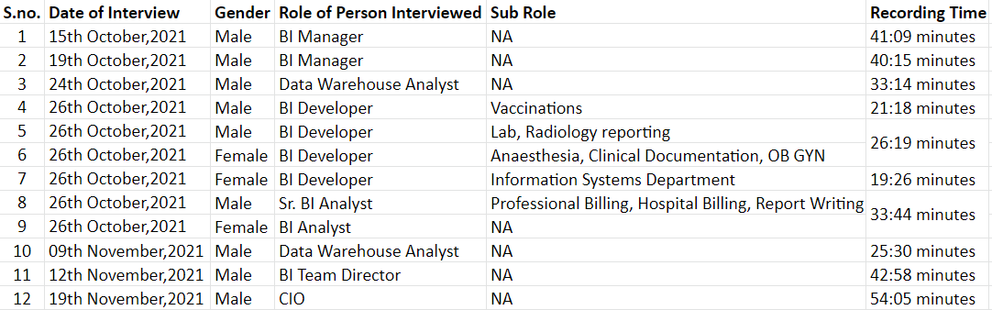
PROJECT APPROACH
Conducted 12 interviews with various Information Technology executives and managers of UI Health that lasted over 6 hours.
Gathered information about various Information Technology changes adopted by other hospitals.

Slide 6
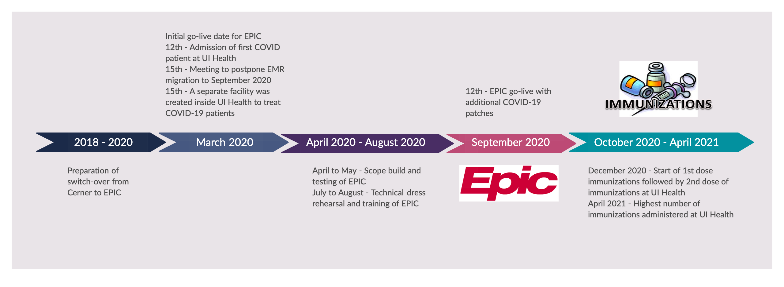

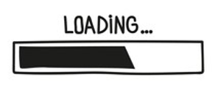
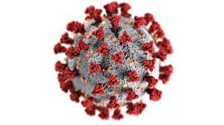
UI HEALTH TIMELINE

Slide 7


EMR MIGRATION PLAN (2018-2020)
Clean up of data from the old EMR systems, other interfaces and billing systems.
Plan to consolidate all the independent applications to develop single repository for patient data.
Project kick-off to move from old EMR system (Cerner) to EPIC by March 2020.
Development of mobile application and patient portal for appointment scheduling.
Source: https://seekvectorlogo.com/cerner-vector-logo-svg/
Source: https://www.exerciseprolive.com/home-exercise-software/epic-logo/

Slide 8
POST COVID-19 (MARCH 2020) : ORGANIZATIONAL CHANGES
On 12 March 2020, UI Health admitted its first coronavirus patient.
Separate facility was created inside UI Health to treat COVID-19 patients.
Adoption of ‘command center’ approach, which re-established the chain of commands & included quick ‘imperfect’ decisions.
Release of COVID-19 dashboards thrice a day for 2 months.
As per regulatory norms, UI Health released regular data updates to the Illinois Department of Public Health (IDPH) and Chicago Department of Public Health (CDPH).
Cancellation of all nonessential ambulatory services & planned surgeries to control virus contamination.

Slide 9
POST COVID-19 (APRIL 2020 – AUGUST 2020) : IT CHANGES
COVID-19 related:
Adoption of readily available teleconferencing tools (Zoom) to initiate tele consultation.
All COVID-19 system requests assumed high priority.
Triage tents with IT infrastructure were set up to screen patients for coronavirus.
Creation of new dashboard focusing on COVID-19 metrics.
EPIC related:
Meeting conducted (~120 executives and CIO) to conclude the postponement of the EMR migration from March 2020 to September 2020.
Digital vendors (Cerner, EPIC and others) & UI Health mutually relaxed the contractual penalties from project delay and no new change requests were charged.
All activities such as new EMR testing, training and meetings were moved online.

Slide 10
POST COVID-19 (SEPTEMBER 2020) : IT CHANGES
Migration of EMR system to EPIC on 12th September 2020.
Deployment of new developments in EPIC based on COVID-19 requirements.
Creation of personalized space for patients inside MyChart containing past and future appointments, primary physician information, prescription, and vaccination information.
Utilization of EPIC for contact tracing.

Slide 11
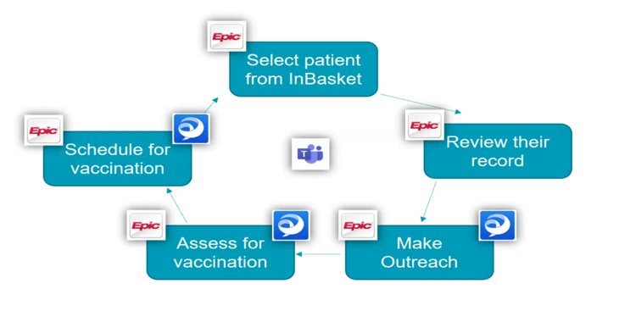
POST COVID-19 (OCTOBER 2020 – APRIL 2021): IT CHANGES
Utilization of EPIC to administer vaccinations.
Release of targeted emails and text messages to the registered patients of UI Health based on specific segmentations to boost immunization.
Introduction of open scheduling to boost immunization.
Determination of heat areas based on the vaccinated population by area.
Project SUPPORT was launched to initiate outbound calls for vaccine appointments.
Project SUPPORT workflow
Source: https://uihealth.uic.edu/ui-health-project-support/

Slide 12
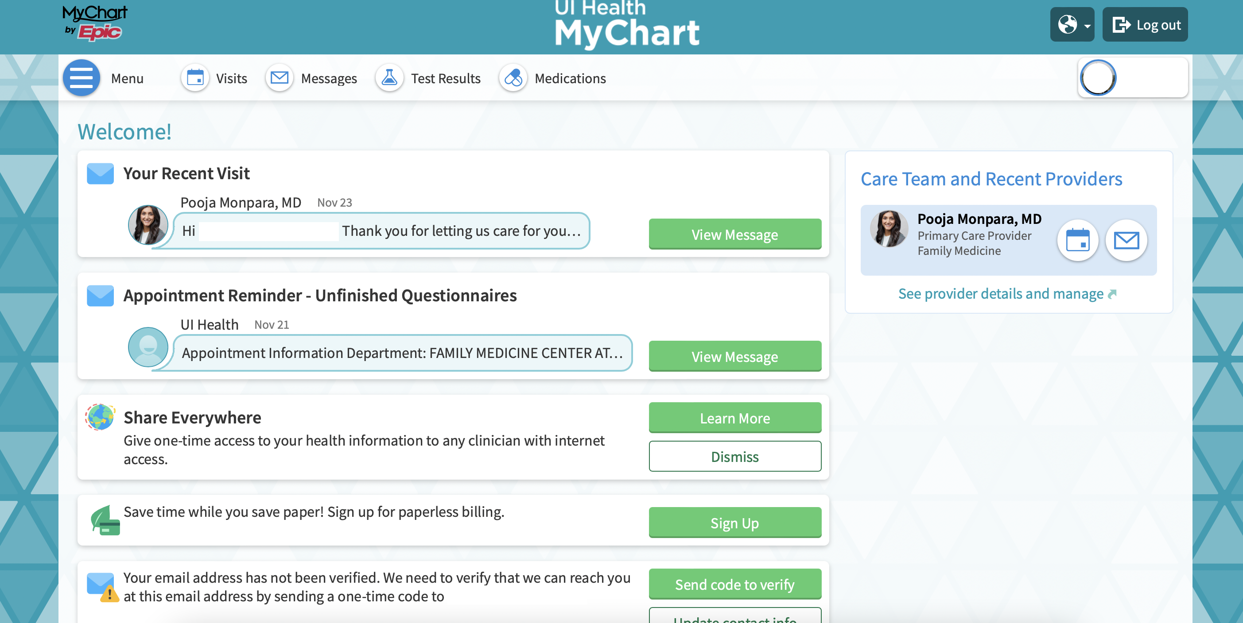
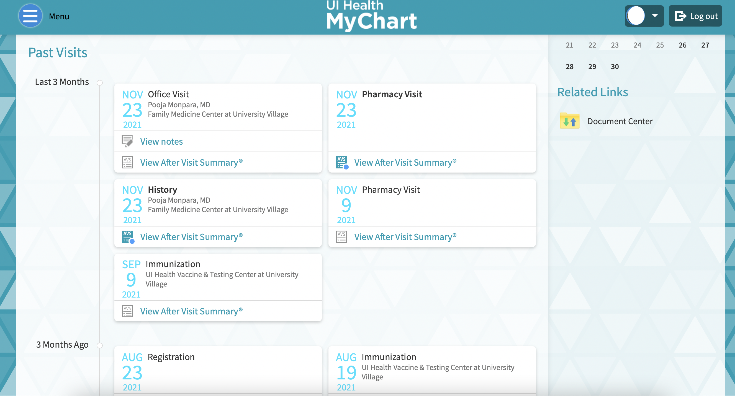
Findings: Epic MyChart Adoption
40% of UI Health patients are active in Epic MyChart.
Source: MyChart mobile application

Slide 13
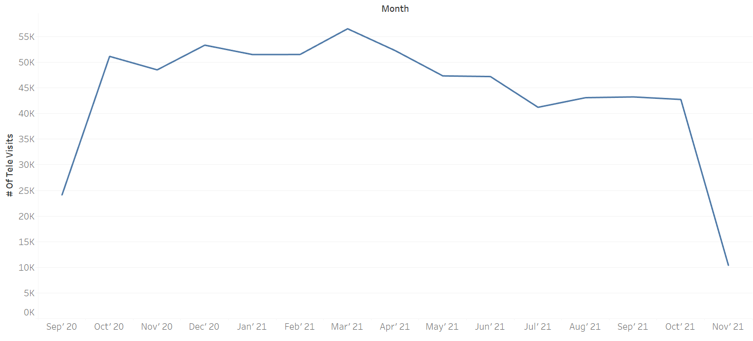
Findings: Telehealth APPOINTMENTS
Tele appointments were mostly suggested for patients who did not need serious diagnosis.
A decline in the number of tele-visits since October 2021 as hospitals resumed all the services completely.
Number of tele appointments after going live with EPIC
Source: Internal company records

Slide 14
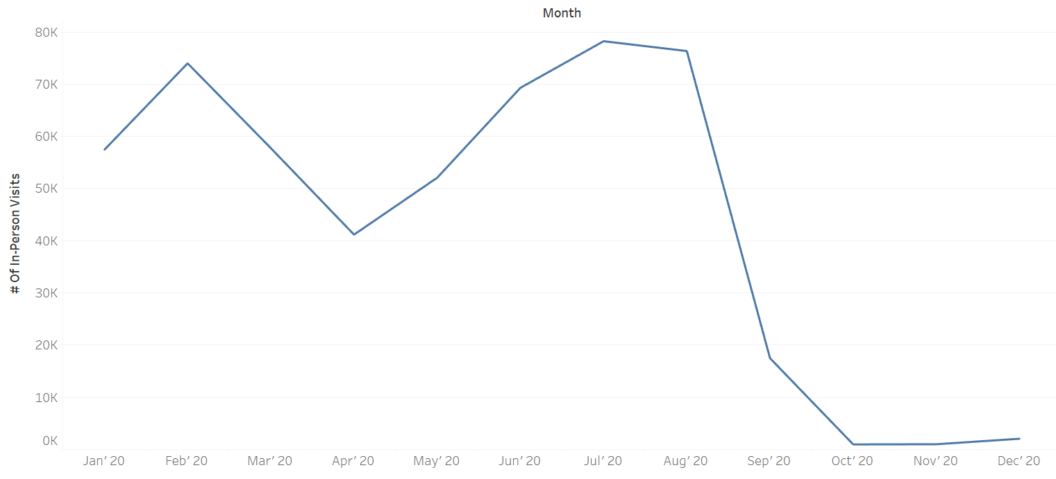
Findings: IN-PERSON PATIENT VISITS
The number of in-person patient visits declined drastically from August 2020 due to:
Decision of UI-Health to cancel in-person visits with an exception for emergency cases.
Most of the in-person visits were replaced with televisits as the new EMR system EPIC was live.
Common flu and other common illness cases almost came down to zero due to home quarantine.
Source: Internal company records

Slide 15
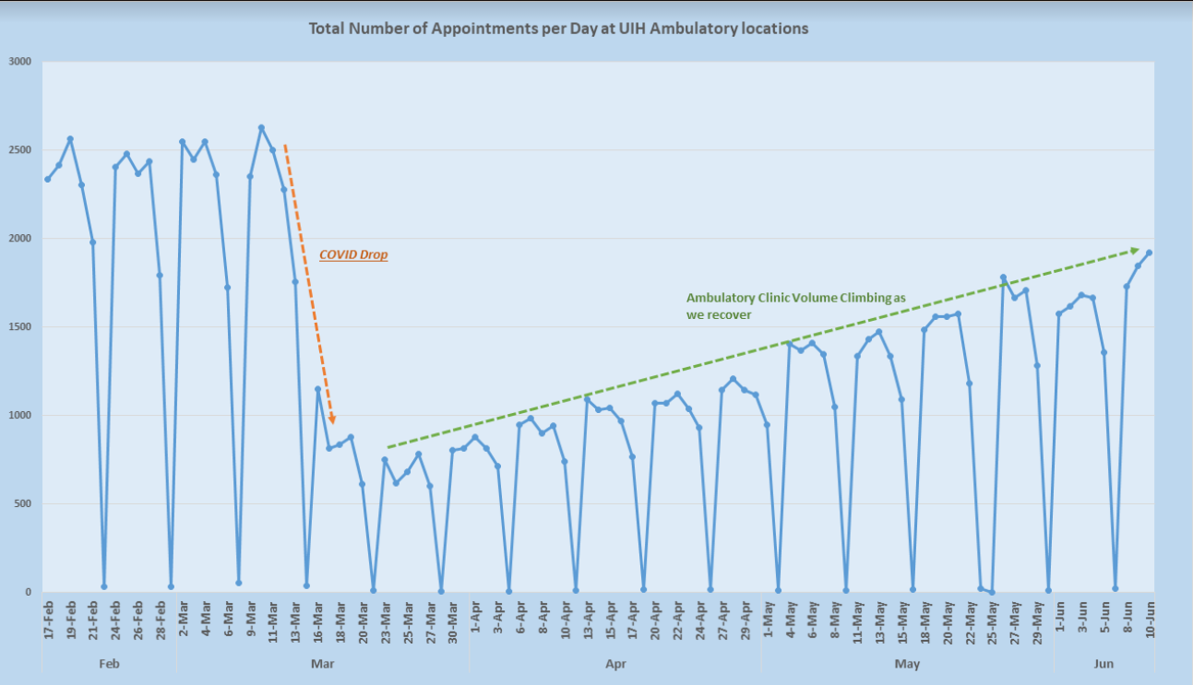
Findings: APPOINTMENTS AT Ambulatory LOCATIONS
On 10th June 2020, UI Health had about 1945 visits, the highest since COVID-19 drop.
As per UI health, on an average, there were about 2400-2500+ appointments per day at the ambulatory locations during the COVID-19 peak.
A drop in the number of appointments can be seen as COVID-19 became an issue in Chicago.
A definite recovery can be observed as appointments were climbing back up.
The many weekly drops seen on the graph are for Saturdays as only few clinics are open on Saturdays.
Source: Internal company records

Slide 16
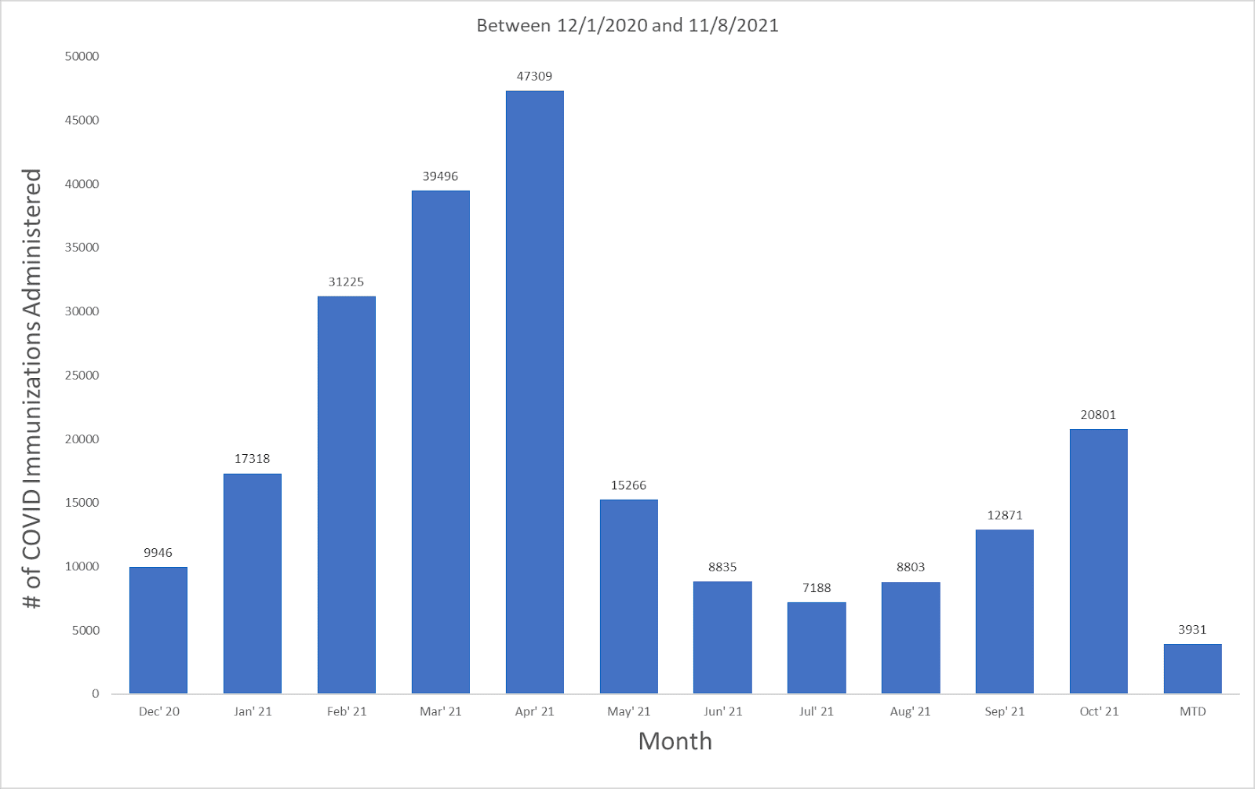
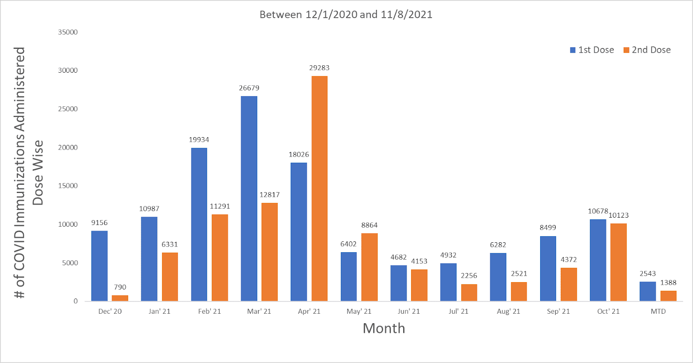
Findings: COVID-19 IMMUNIZATIONS ADMINISTERED
In April 2021, highest number of immunizations (47,309; 1st dose+2nd dose) were administered. Followed by, 39,496 immunizations in March 2021. Around 150,000 total vaccination doses were administered.
The highest number of 2nd dose shots in April 2021 can be attributed to the highest number of 1st dose shots in March 2021 and previous 1st dose shots.
Immunizations administered by month
Immunizations, bifurcated into first dose and second dose by month
Source: Internal company records

Slide 17
Challenges
Organizational:
Revenue hit due to planned surgeries cancellation & long shelved pharmacies.
Virus spread among staff members hindering project progress.
IT:
Work From Home Policy.
Online trainings led to low engagement of the EPIC trainees (providers and end-users).
Some physicians preferred in-person consultation over tele consultation.
EMR migration delayed due to the pandemic.
Low adoption of telehealth by aged population.

Slide 18
Lessons Learned
Strong leadership & futuristic vision is imperative in organizations to drive ‘transformational’ projects.
Adoption of new technology can prepare organizations to operate within uncertain times, such as work from home, and social distancing.
Identification of specialized human resources for dated technologies creates a barrier for system migration.
The design principle around products should account for easy adoption by non-tech-savvy users as well.

Slide 19
Lessons Learned (CONTd.)
Users of digital solutions (telehealth in this case) can experience burnout, like how physicians at UI Health did. This can become a pressing problem for the adoption of digital solutions.
Realizing the increased productivity and increased profits due to remote work, many organizations have adopted this as the new way to work, COVID-19 has unleashed new digital ways of working, collaborating, and conducting business.

Slide 20
Recommendations
Based on our interviews with the stakeholders of UI Health, we observed that, while solutions for remote consultation were implemented, there is still untapped potential in remote vital monitoring solutions for home quarantine patients & virtual physician appointments.
Possible Costs: Bluetooth enabled monitoring devices and equipment rental, web interfaces and mobile application development, and support, provider costs.
Possible Outcome: Will lead to low virus contamination at hospital, decreased hospital costs, and low waiting time at OPDs.
A simplistic and intuitive UX/UI to overcome adoption impediments.

Slide 21
REFERENCES
https://uihealth.uic.edu/ui-health-project-support/
https://seekvectorlogo.com/cerner-vector-logo-svg/
https://www.exerciseprolive.com/home-exercise-software/epic-logo/
MyChart mobile application
Internal company records

Slide 22
Recommendations
THANK YOU

